Slide 1
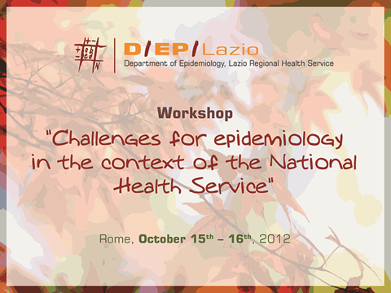

Slide 2

Health effects from waste contaminated sites: epidemiology, policy makers, economical interests and population worries.
Carla Ancona e Francesco Forastiere
Occupational and etiological epidemiology unit

Slide 3
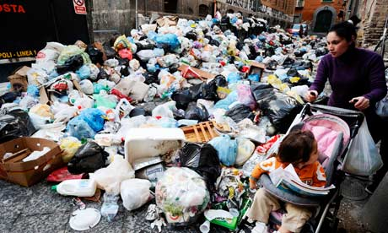
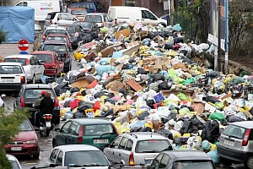
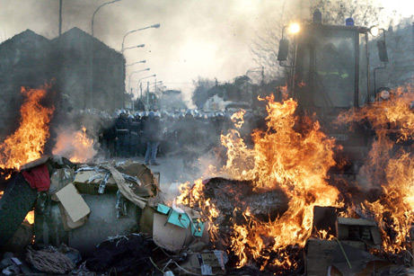
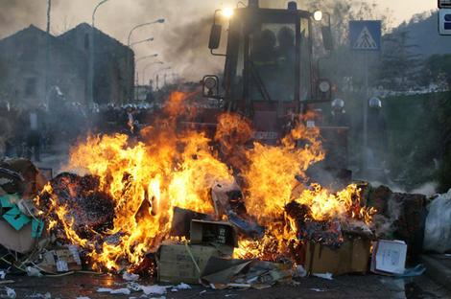
Naples’ trash emergency, 2008
Notes:
Trash collection in Naples and surrounding towns stopped on December 21, when collection agencies reported that local dumps were all full. Municipal workers refused to pick up trash in part because the surrounding region’s landfills were at full capacity because of illegal dumpings.
Residents have since turned out in protest, not to pressure the government to haul off the waste but to block efforts to open new landfill sites in their neighborhoods.
Police in riot gear stand behind a barricade of trash set ablaze by protesters.

Slide 4

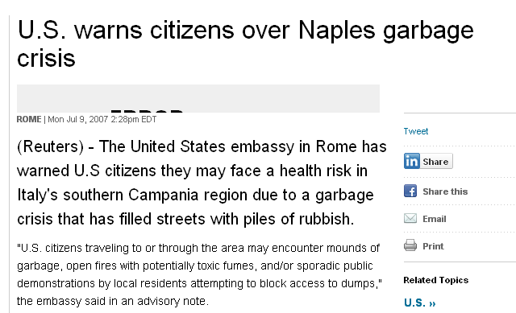

Slide 5
Technical and organizational
errors
The reasons
local bureaucratic
incompetence
Political interests
Indifference from
the national government
Plant operators
(industry)
Ecomafia interests
organized
crime syndicates
Notes:
Only a theoretical regional policy for waste treatment

Slide 6
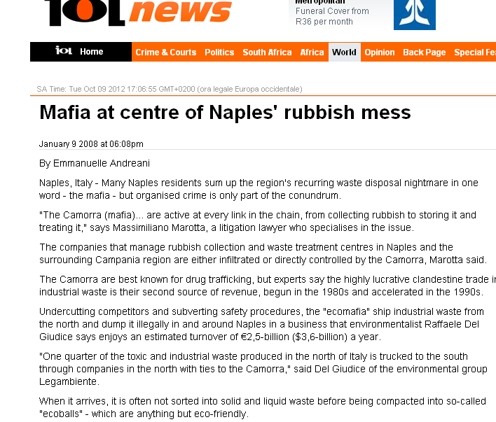
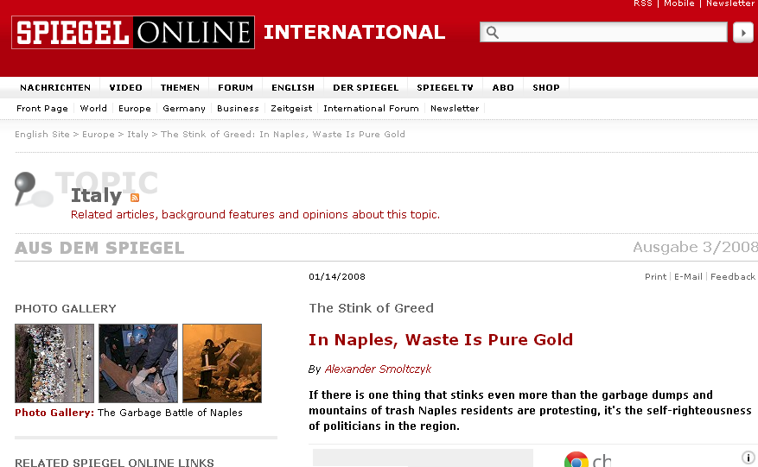
ecomafia

Slide 7
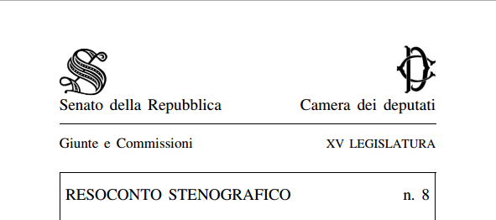
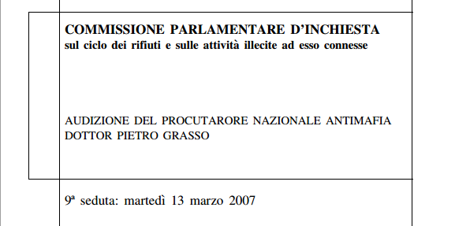
Notes:
A report to the senate of the italian republic of the national anti-Mafia prosecutor

Slide 8
"The Camorra (mafia) is best known for drug trafficking, but the highly lucrative clandestine trade in industrial waste is their second source of revenue, begun in the 1980s and accelerated in the 1990s.
….they are active at every link in the chain, from collecting rubbish to storing it and treating it…
One quarter of the toxic and industrial waste produced in the north of Italy is trucked to the south through companies in the north with ties to the Camorra
€2,5-billion ($3,6-billion) a year

Slide 9
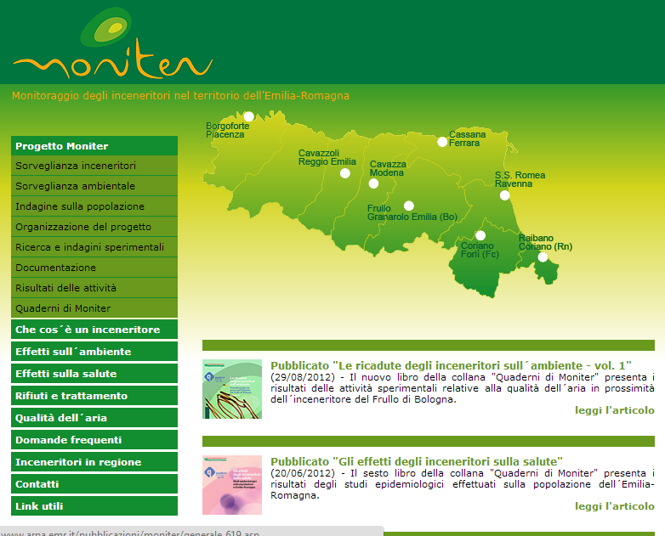

Slide 10
http://www.arpa.emr.it/moniter/index.asp
characterization of emissions from incinerators
Incinerators and environmental monitoring
Incinerators and health
Notes:
Moniter is a high quality project

Slide 11
http://www.arpa.emr.it/moniter/index.asp
multidisciplinary team
line project devoted to communication
timely inclusion on the website of the reports of completed actions
rigorous scientific committee
Notes:
Moniter is a high quality project

Slide 12
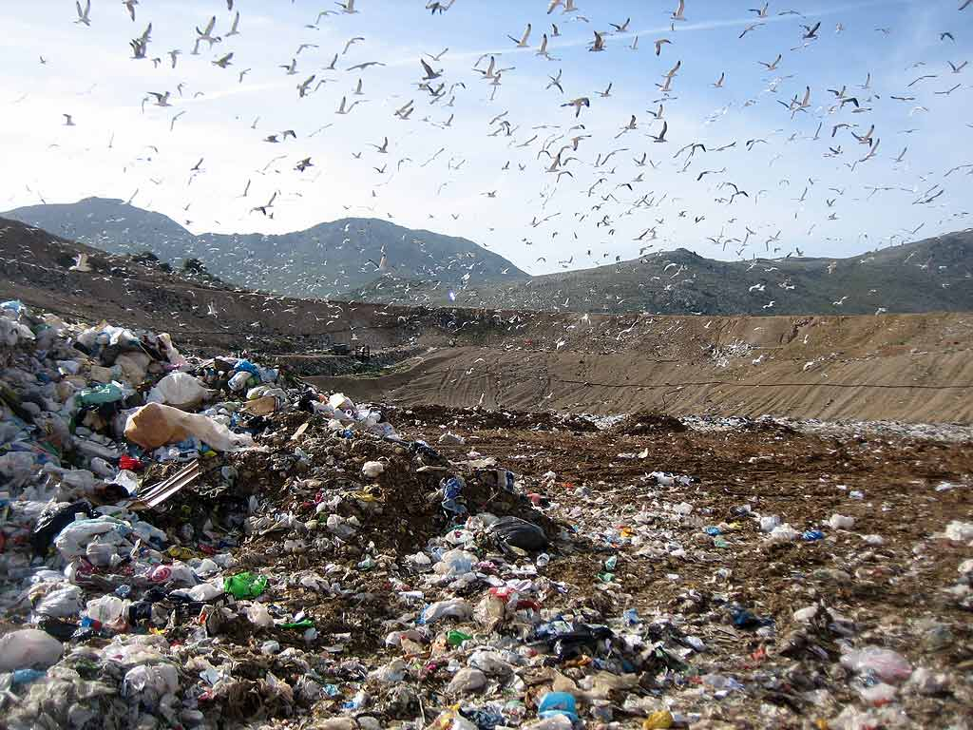
Lazio, Malagrotta landfill (Rome)
Notes:
Every day five thousand tons of trash show up at what is Europe’s largest landfill, some converted to energy through incineration or gasification, but the rest piled up as landfill.
And since 2008 this landfill has been full.

Slide 13
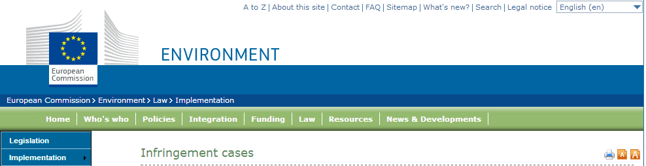
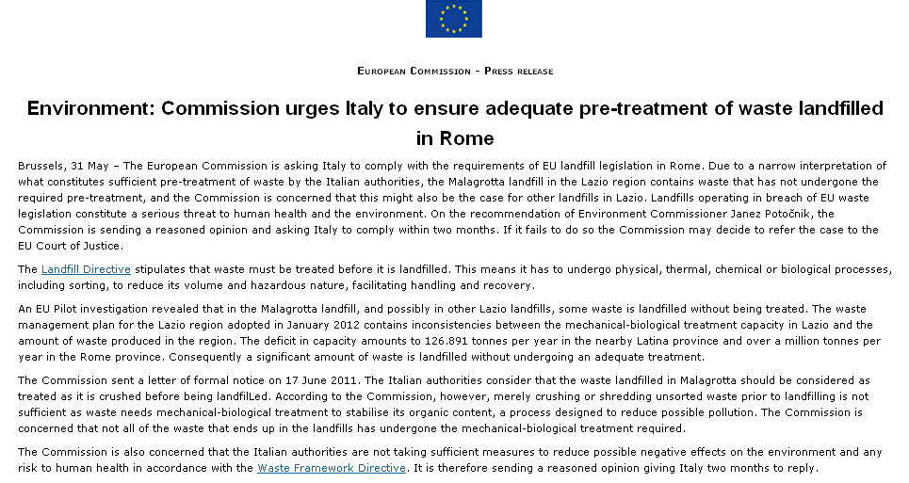

Notes:
A formal warning

Slide 14

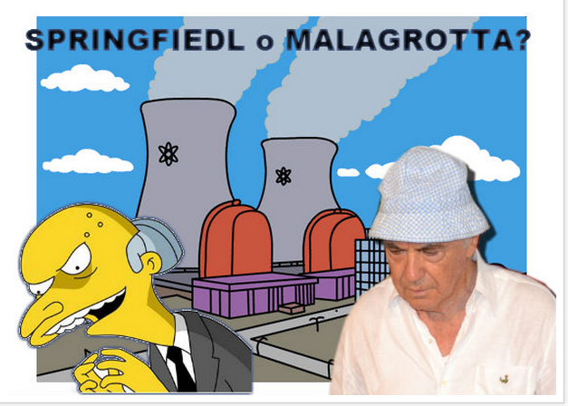
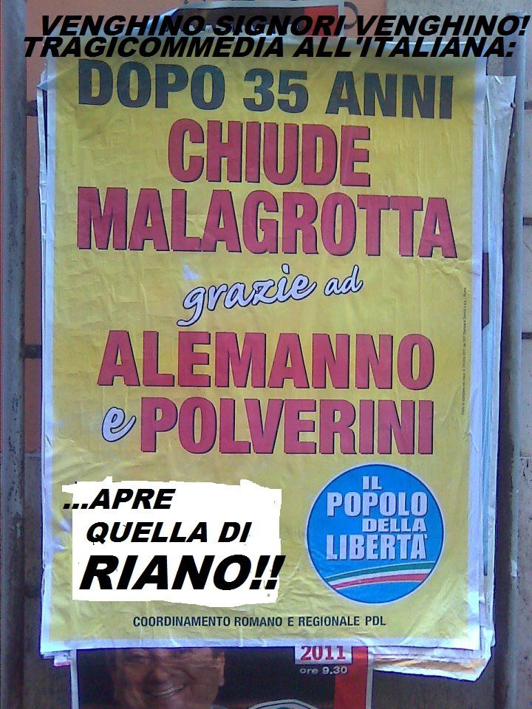
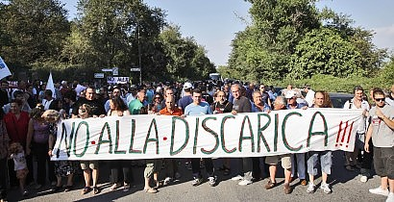
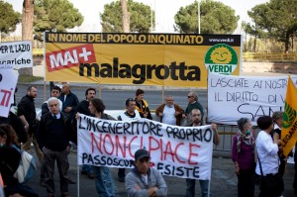
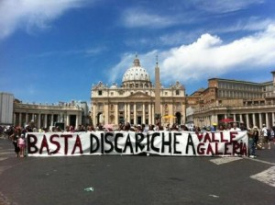


Slide 15


Slide 16
Literature review
To estimate emission
To characterize the potentially exposed population
To evaluate the environmental health effect
To evaluate the occupational health effects
Web site for communication

Slide 17
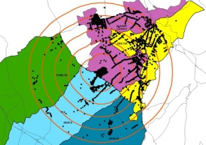


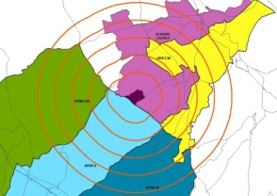
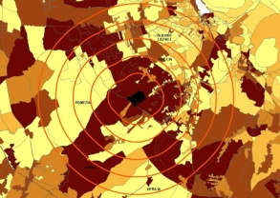

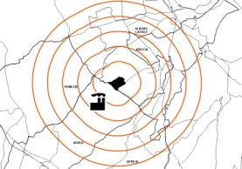
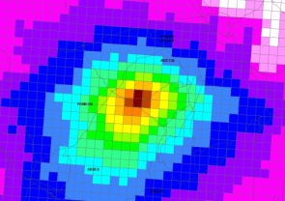



Study design - Environment and Health
Geocoding procedure
Occupational history
Municipality data
Population cohort
Socioeconomic level
Study area definition
Epidemiological evaluation
t₀
t₁
Follow-up
Pollution source
Dispersion model (footprint)
Exposure-response
relationship
Meteorology
Other pollution sources
Orography
Environmental monitoring

Slide 18
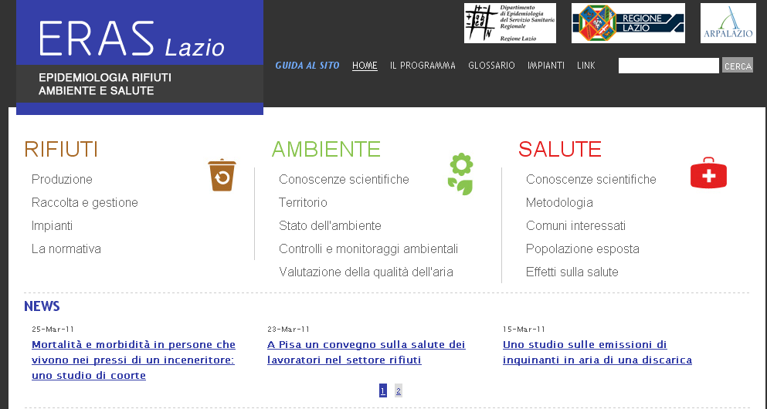
www.ERASlazio.it

Slide 19
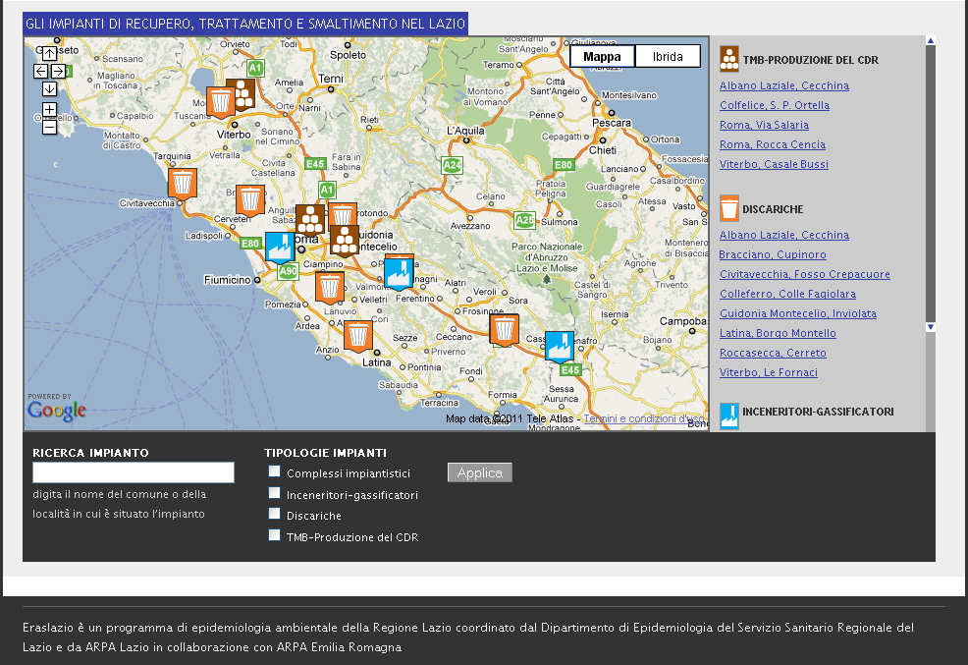

Slide 20
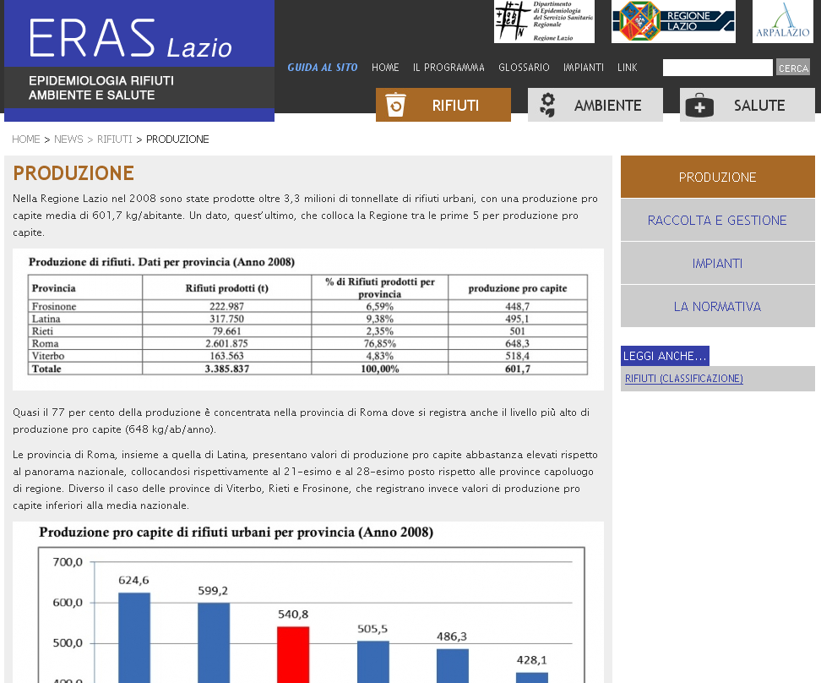

Slide 21
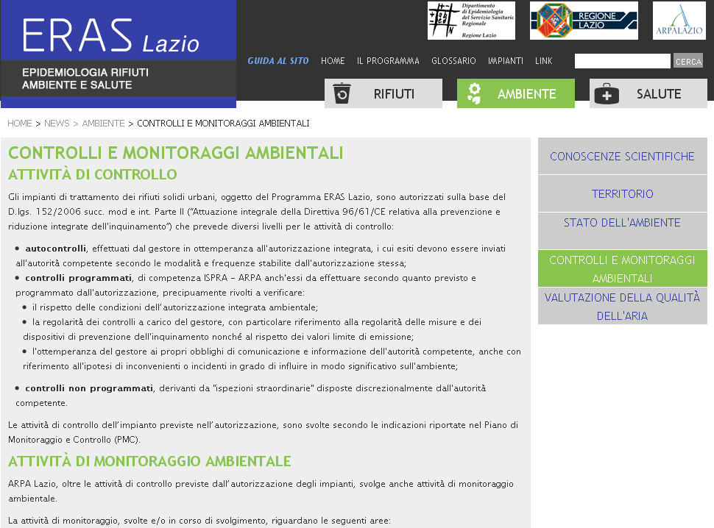

Slide 22
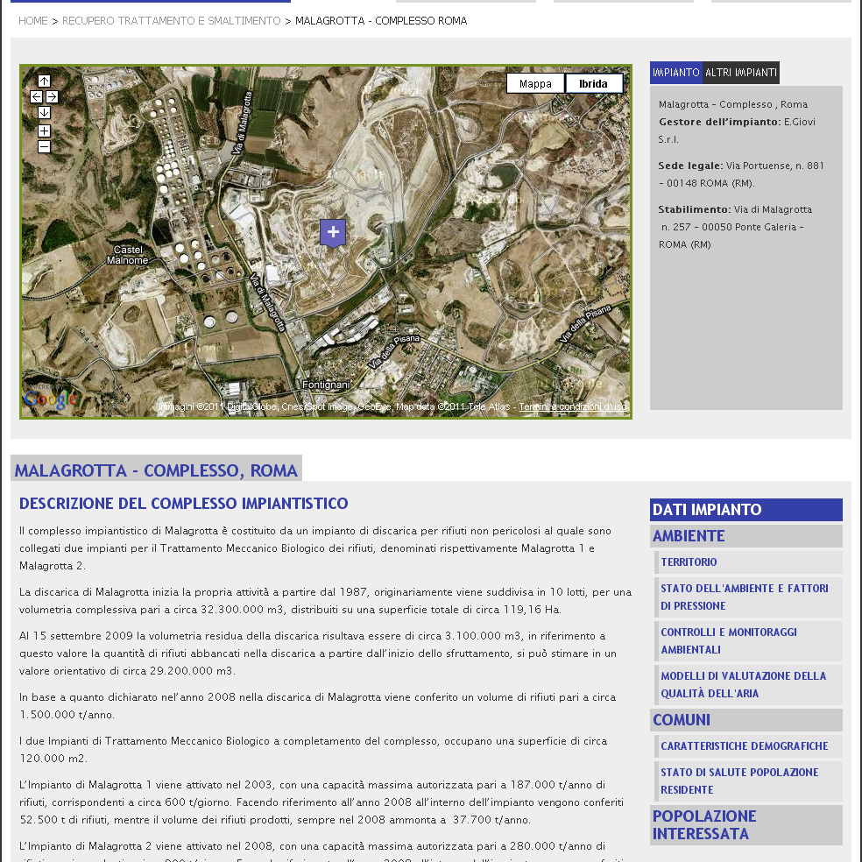

Slide 23
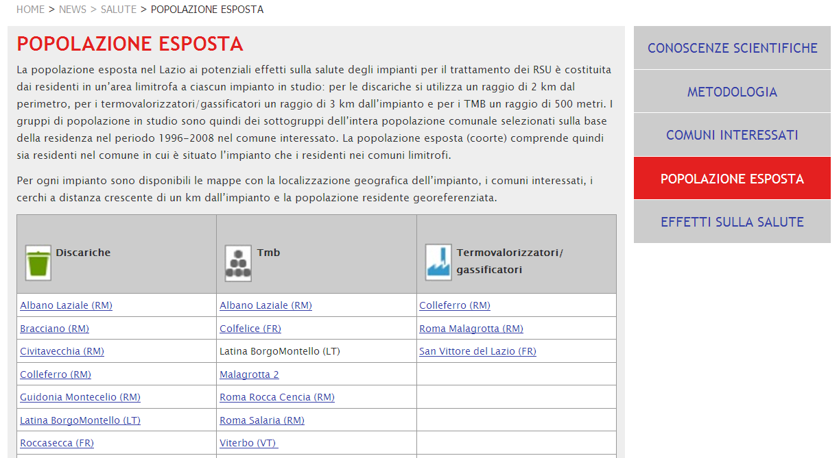

Slide 24
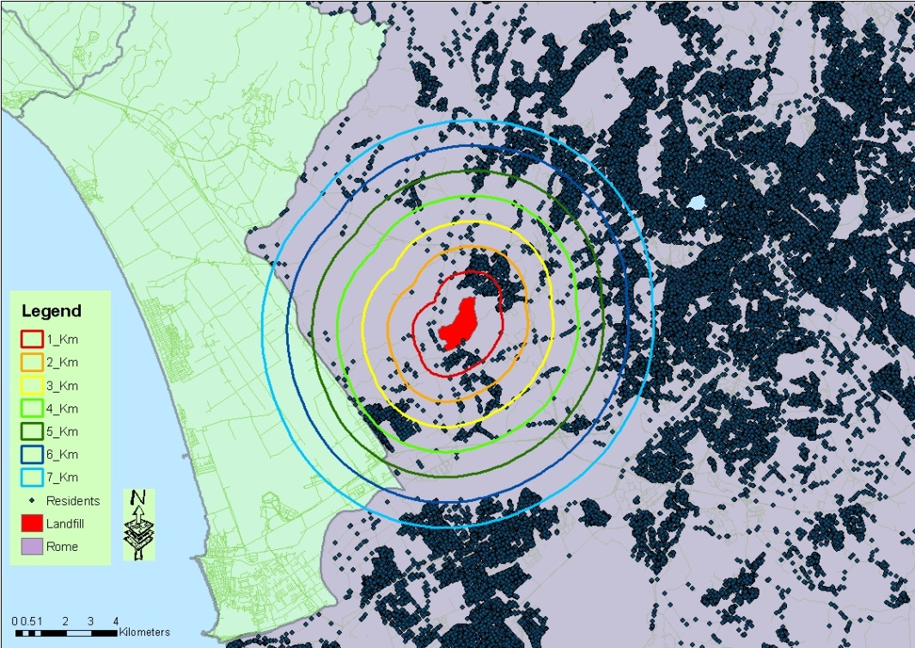
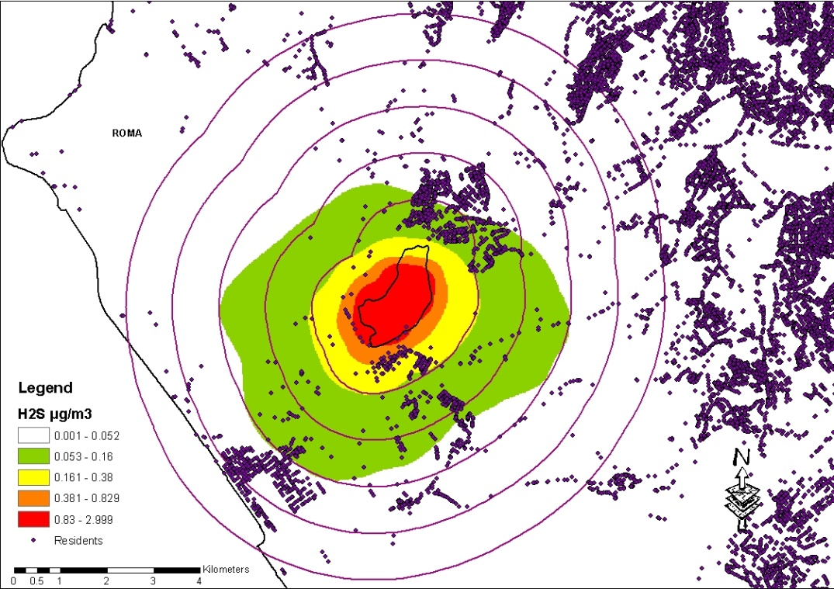
waste plants: exposure assessment
distance from the plant
Hydrogen sulfide concentration (H₂S)
Water and soil pathways
Air pathway

Slide 25
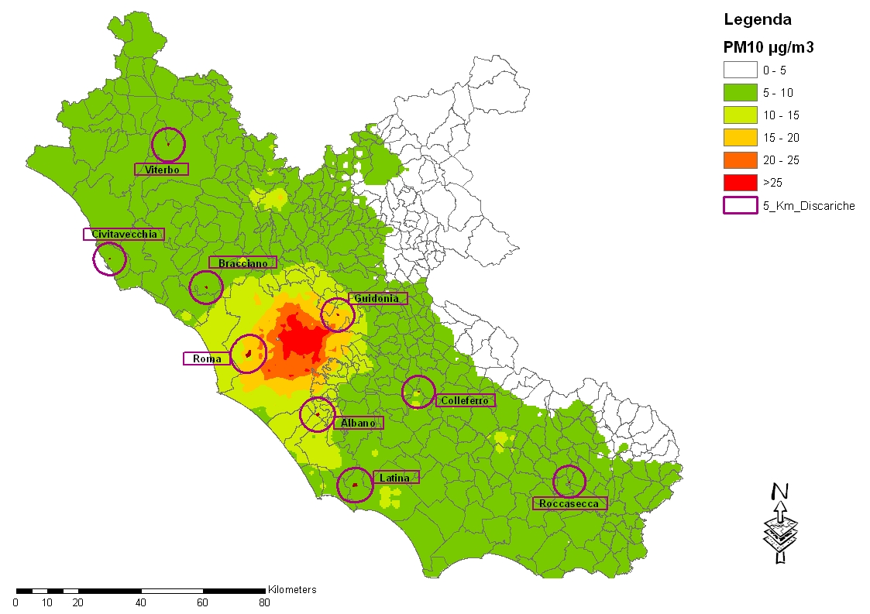
Metodi: confondenti (2/4)
Concentrazione media annua di PM10

Slide 26
Results

Slide 28
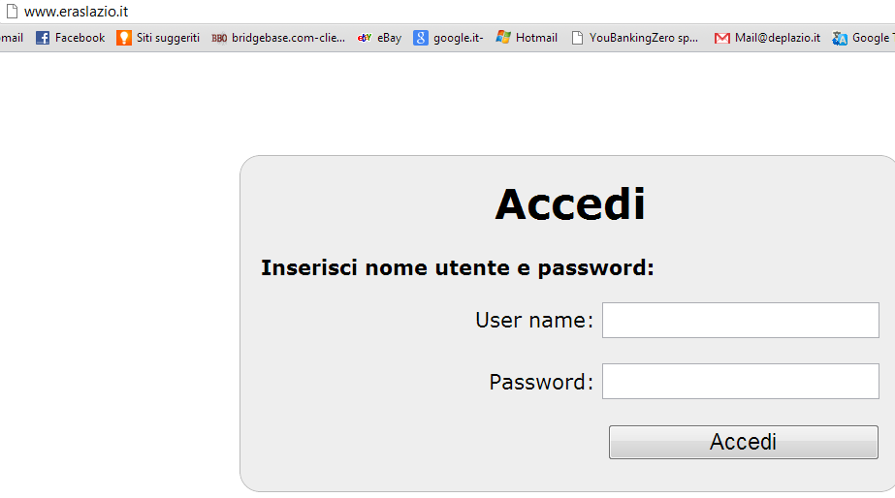
On july 2012 the report was sent to the Lazio region authority
www.eraslazio.it

Slide 29
http://www.arpa.emr.it/moniter/
Notes:
Let’s step back to moniter results

Slide 30
From the final evaluation of the Scientific Committee of the results of Moniter
emissions below the legal limits
cohort of residents. the results are reassuring on the whole (with the exception of non Hodgkin disease)
Pregnancy outcomes: increased risk of preterm birth (also small for gestational age increase)
the health impact of incinerators in Emilia-Romagna
is contained, but is not null

Slide 31
The press release (Bologna, dec 2 2011)
emphasized the lack of excess cancer risk (avoided mentioning the signal of the N-H disease)
softened the interpretation of the effects on the outcome of pregnancy, as they fall "within the regional average“
pointed out that there was no evidence that preterm birth influenced the future health of the unborn
Political reassurance
B. Terracini http://www.epiprev.it/lettera/moniter-discussioni-intorno-un-comunicato-stampa Epidemiol Prev 2012; 36 (1),

Slide 32
the position of the committees anti-incinerators
Population worries
discrediting the methodology

Slide 33
Toward a public understanding of environmental epidemiological studies results
maximum transparency (protocol, methods, reports)
integration between epidemiologists and risk communicators

Slide 34
Toward a public understanding of epidemiological studies results
evidence
Inform policy
Inform public
?

Slide 35
Francesca Mataloni, Simone Bucci, Martina Nicole Golini, Chiara Badaloni, Silvia Narduzzi, Mirella Salatino, Patrizia Compagnucci

