Slide 1


Slide 2
Volume of care and outcomes: synthesis of the available evidence.
Eliana Ferroni
16th October 2012

Slide 3

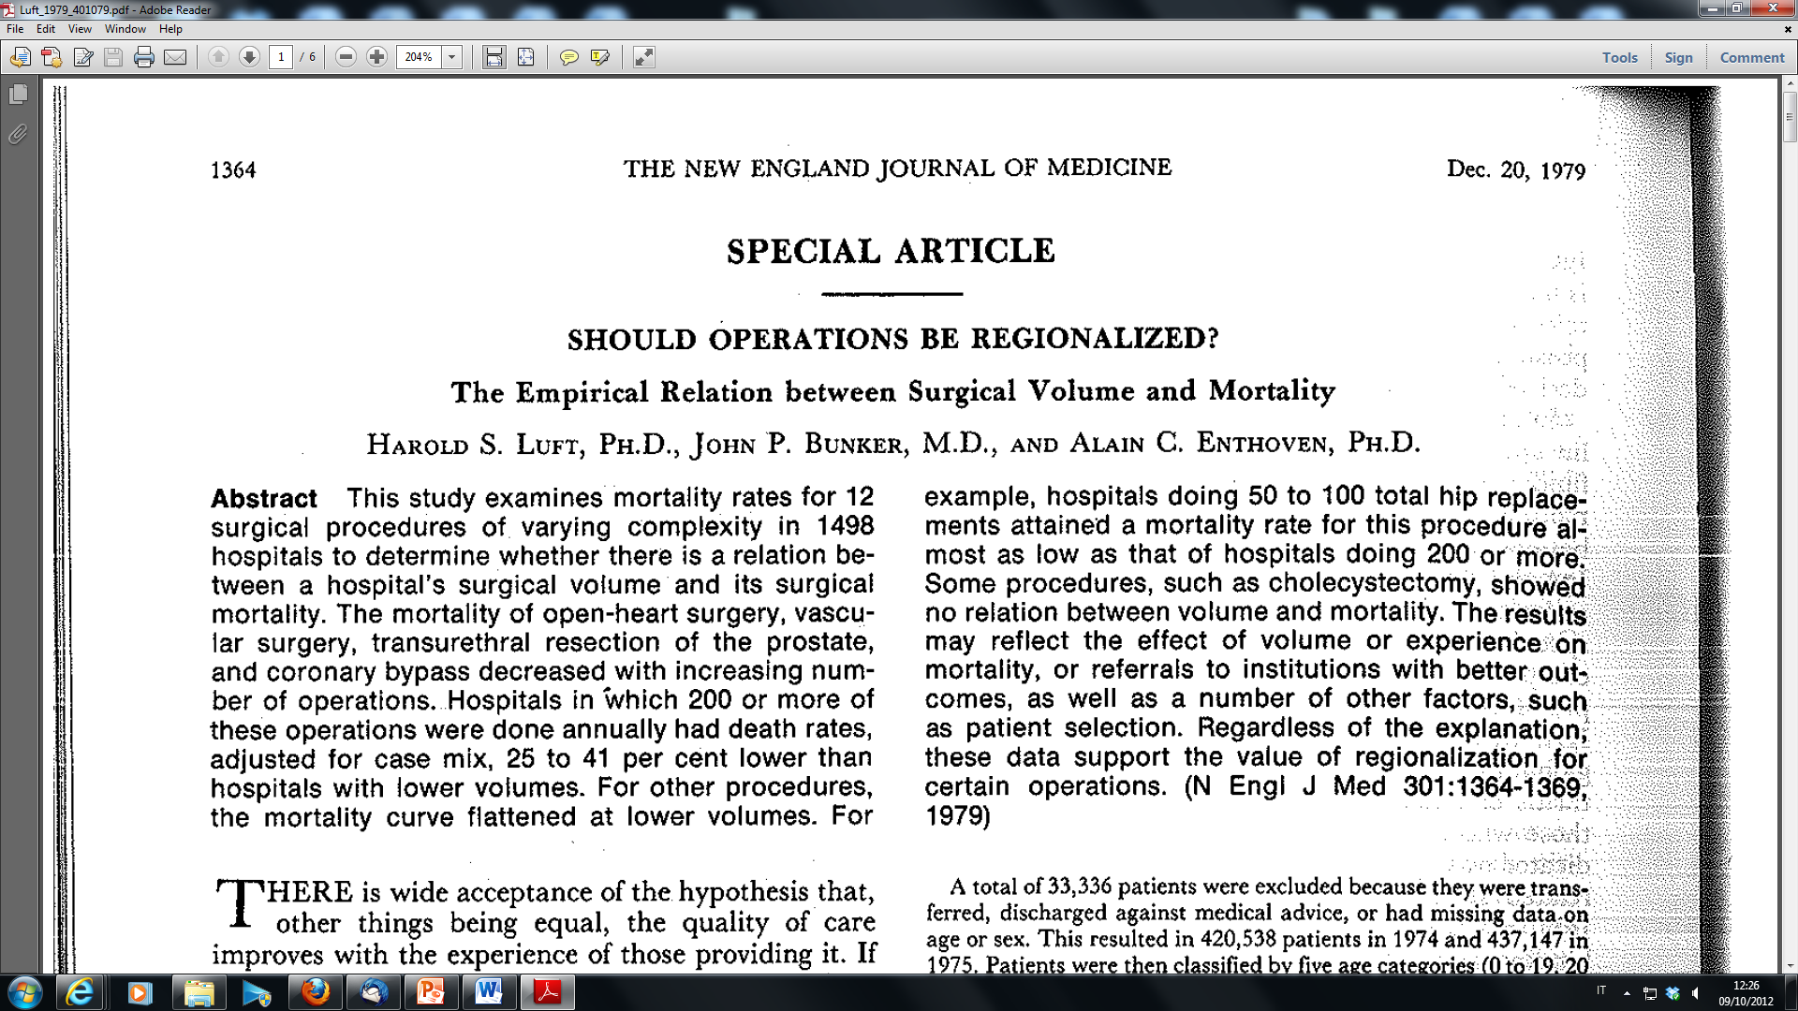
Volume of care and outcomes: synthesis of the available evidence.
Notes:
As far back as the 1970s studies had begun to identify a link between higher mortality (more deaths) and low surgical volume (less experience with a particular operation). One of the first study, dated 1979 called it even an empirical relation, an hypothesis still to be demonstrated.

Slide 4
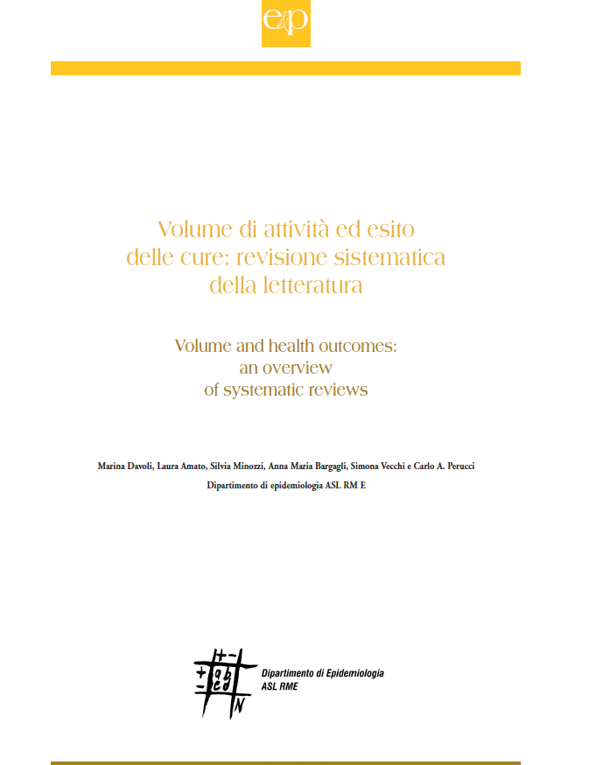

Background
In 2005 we published an overview of systematic reviews (SRs) –updated this year- aiming at identifying areas, clinical conditions/interventions for which an association between volume and outcome could be demonstrated.
Main outcome: intra-hospital /30-day mortality
Update 2012
Notes:
Thirty years later hospital and surgeon volumes represent measurable variables with proved and relevant impact on health care services. The number of studies reporting inverse relationship between hospital volume and surgical mortality is growing, and as a consequence of the results showed, there was in some countries (ie USA) a considerable interest in concentrating selected operations in high-volume hospitals.
With this background some years ago the National Agency for Regional Health Services commissioned to the Department of Epidemiology to perform an overview of systematic reviews, which was recently updated and is going to be published early next year. The aim the overviews was to identify areas, procedures, interventions for which an association between volume and outcome could be demonstrated.
Different outcomes were measured, all the reviews assessing intra-hospital/30 day mortality, which was then considered the main outcome of the overview.

Slide 5

Methods
Search strategy on:
Electronic databases: PubMed; EMBASE; The Cochrane Library (February 2012)
Health Technology Assessment (HTA) websites (February 2012)
National guideline Clearinghouse (February 2012)
Notes:
Literature search was made through the following sources

Slide 6
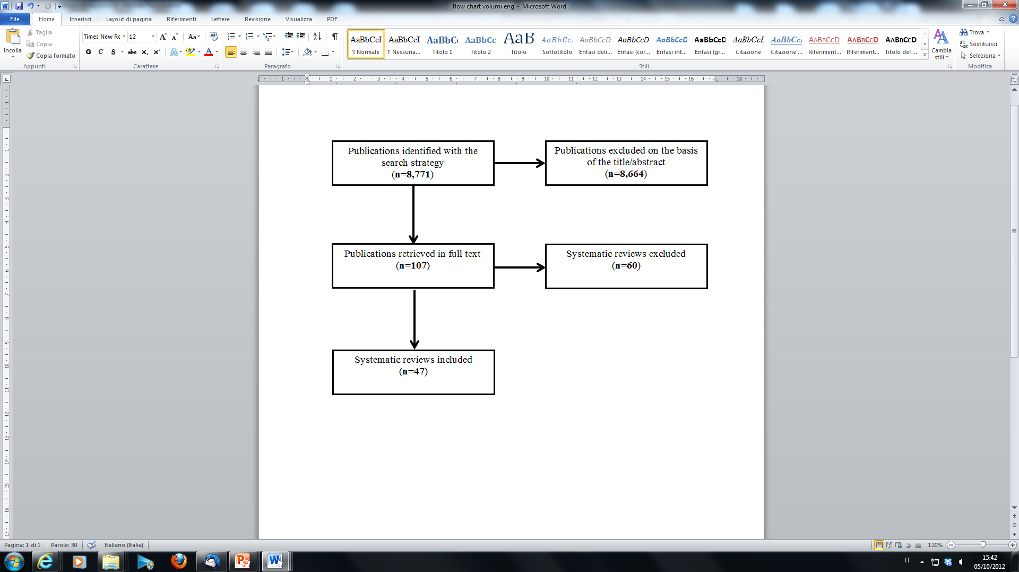
Flow chart
Notes:
This is the flow chart of the literature search, overall we included 47 systematic reviews on 38 different clinical areas.

Slide 7
Methods
According to the main outcome, health topics were classified in the following groups:
positive association: a positive association was demonstrated in the majority of studies/participants and/or a pooled measure (metanalysis) with positive results was reported.
Lack of association: no association was demonstrated in the majority of studies/participants and/or no metanalysis with positive results was reported.
Association not measurable: both results of single studies and metanalysis do not allow to draw firm conclusions on the association between volume and outcome
Notes:
The clinical areas evaluated were then classified into three groups, according to the main outcome:
- positive association, when a positive association was demonstrated in more than half of the studies or participants, and/or a pooled measure with positive results was reported.
- lack of association, when no association has been demonstrated in the majority of studies/participants and/or no metanalysis with positive results have been reported.
- association not measurable, when both results of single studies and metanalysis, when present, do not allow to draw firm conclusions on the association between volume and outcome

Slide 8
Positive association
hospital volume ►intra-hospital /30-day mortality
N=26
1 | Aids | 14 | Prostate cancer surgery
2 | Colecistectomy | 15 | Kidney cancer surgery
3 | Neonatal intensive care | 16 | Stomach cancer surgery
4 | Hip fracture | 17 | Coronary artery bypass;
5 | Knee arthroplasty | 18 | Pediatric heart surgery
6 | Bladder cancer surgery | 19 | AAA unruptured
7 | Colon/rectum cancer surgery | 20 | Subarachnoid hemorrhage
8 | Colon cancer surgery | 21 | Carotid endarterectomy
9 | Esophagus cancer surgery | 22 | Coronary angioplasty
10 | Liver cancer surgery | 23 | Myocardial infarction
11 | Breast cancer surgery | 24 | Lower extremity bypass surgery
12 | Pancreas cancer surgery | 25 | AAA ruptured
13 | Lung cancer surgery | 26 | Cerebral aneurysm
AAA= Abdominal Aortic Aneurysm
Notes:
A positive association was demonstrated for 26 clinical interventions/procedures. In particular, except from 3 health topics, signed in blue, (AIDS, Myocardial Infarction and Neonatal Intensive Care) are all single surgical procedures.

Slide 9
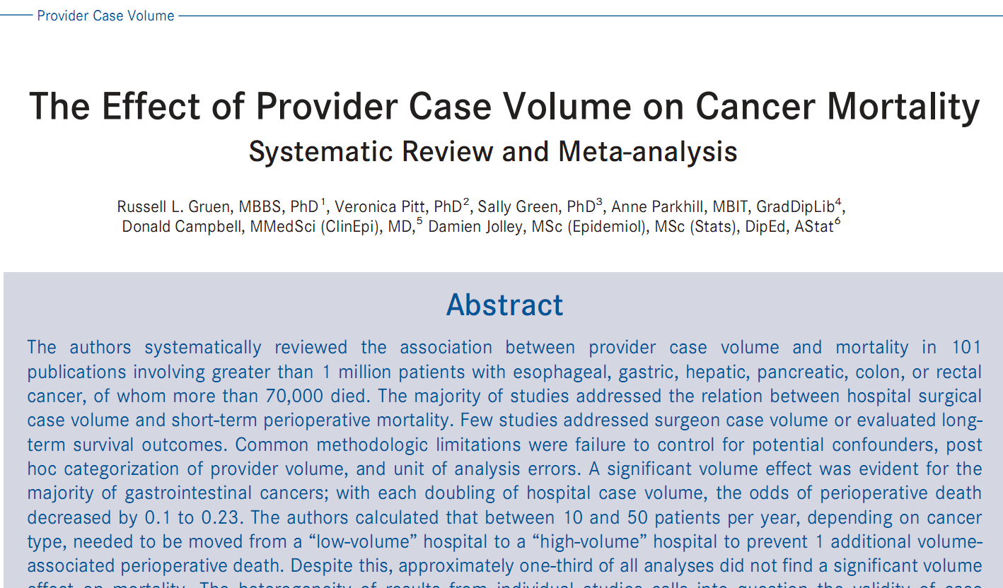
CA Cancer J Clin 2009;59:192-211 ©2009 American
Cancer Society, Inc.
Notes:
This is one of the systematic reviews included.

Slide 10
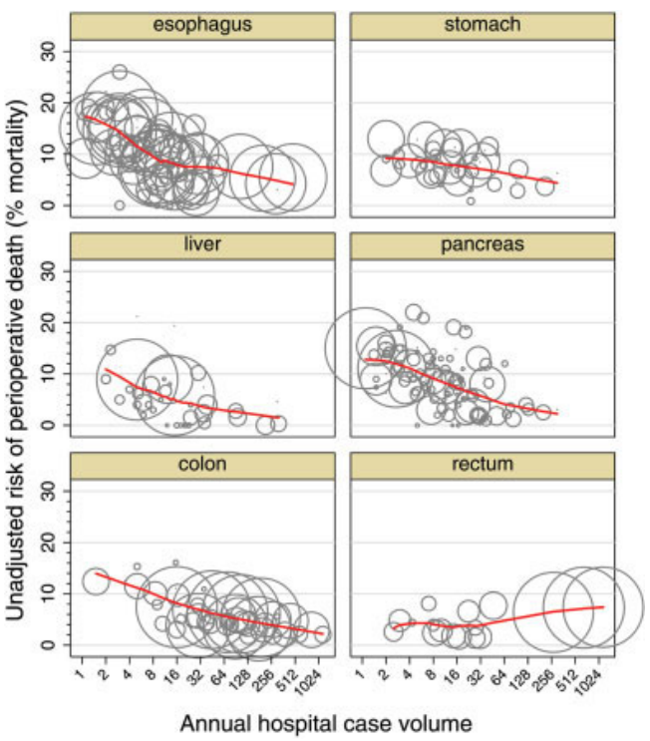
Notes:
This figure was presented in that review. As we can see here, for 5 intervention of cancer surgery (rectum excluded), unadjusted risk of perioperative death decreases with increasing hospital case volume.

Slide 11
Lack of association
hospital volume ►intra-hospital /30-day mortality
N=2
1 | Hip arthroplasty
2 | Rectal cancer surgery
Association not measurable
hospital volume ►intra-hospital /30-day mortality
N=10
1 | Cardiac Catheterization
2 | Aorto-femoral bypass
3 | Pediatric oncology
4 | Testicular cancer surgery
5 | Colectomy
6 | Inguinal hernia
7 | Hysterectomy
8 | Appendectomy
9 | Trauma
10 | Respiratory failure
Notes:
For two interventions, hip arthroplasty and surgery of rectal cancer, no association has been demonstrated, while for the remaining 10 clinical areas it was not possible to measure the association and thus draw any conclusion.

Slide 12
Keypoints
Heterogeneity of studies
Different volume cut-offs reported for the same intervention/procedure
Quality of reporting low:
  Number of patients
  Outcome measure
  Cut - off values
Notes:
Synthesizing results we faced with many methodological issues, due to the heterogeneity of studies included and the great variability of data presented. First of all high volume cut-off values reported by the studies for the same intervention/procedure were different. Also the same study was described differently in different SRs, in terms of number of participants, cut-off threshold and outcome measure, showing sometimes conflicting results for single outcome (the same study provided a positive association in one SR and a negative/unknown one in another SR)

Slide 13
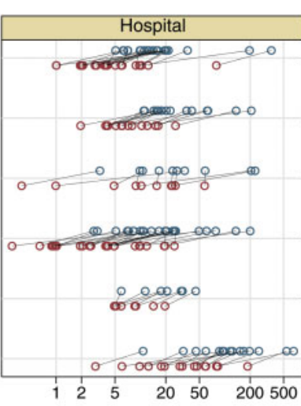
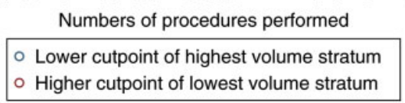
Esophagus
Stomach
Liver
Pancreas
Colon
Rectum
Notes:
In particular, due to the high variability of volume cut-offs values reported, for some interventions, like stomach cancer surgery, in one study the value of the lower cut point of highest volume stratum was even lower than the value of the higher cut point of lowest volume stratum of another study, making difficult, if not impossible, the definition of the high volume threshold.

Slide 14
Keypoints
Type of study design (observational)
Bias of the exposure measure (time/measure)
Notes:
Furthermore, since all the studies included were observational and based on administrative hospital data, they used specific methods to control for confounders and for outcome assessment, making their results hardly comparable.
Measure of exposure could be also affected by distortion (i.e. hospital volume vs. department volume).

Slide 15
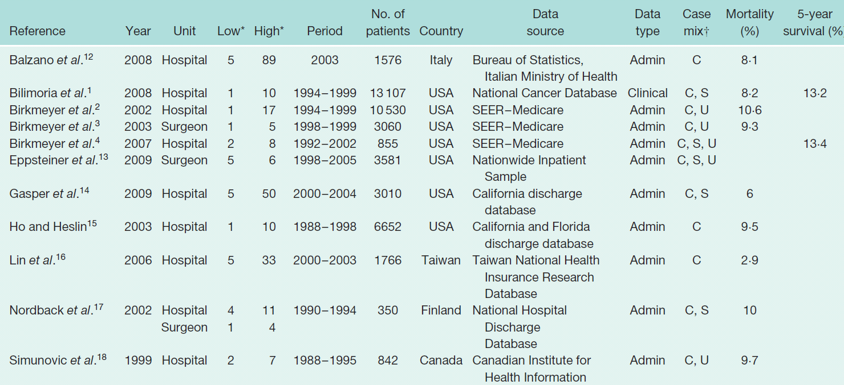

Exposure time
Gooiker et al. Systematic review and meta-analysis of the volume-outcome relationship in pancreatic surgery. Br J Surg 2011; 98(4):485-94.
Notes:
Taking the example coming from studies on pancreatic surgery, we can see that time of exposure in the studies varies, as well as the source of data. Here again it is showed how different are high and low volume cut-off reported by each study on the same intervention.

Slide 16
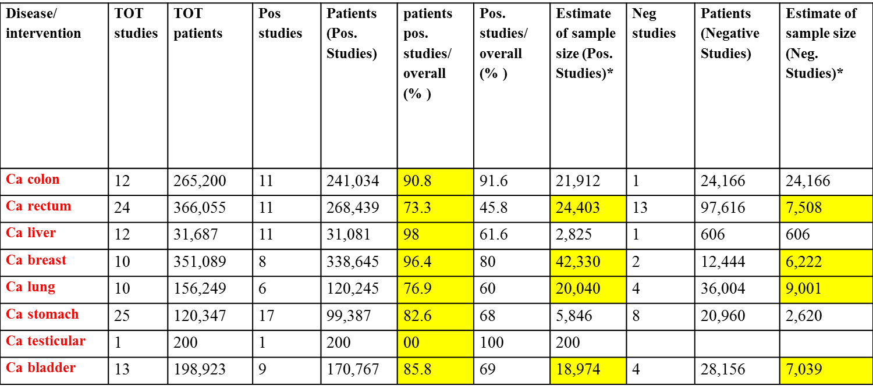
Keypoints
Association measure based on the number of positive/negative studies
Notes:
We based the overall estimate of the association on the results of the metanalysis presented in the reviews, where available. For some cases no metanaysis were presented, so we tried to get an estimate using the “count” of the number of positive studies (and participants) with respect of all studies included. This procedure can bias the true effect of the exposure since negative studies get the same weight of positive ones, irrespective of their statistical power. Small size studies in fact can be not statistically significant while large studies can find a statistically significant difference, between exposed and not exposed, that can be clinically irrelevant.
Counting only the number of studies therefore does not provide information on the real effect size of the intervention.
In order to verify it, we performed an approximate estimate of the sample size of positive and negative studies. As we can see in the table, many positive studies had in average more participants than negative studies. Furthermore, the percentage of patients involved in positive studies on the total of patients were systematically higher in respect of those involved in negative studies.
Finally publication bias should be also considered, since those reporting a significant association between volumes and outcome may have greater probability (more likely to be) to be published in respect of those ones with negative results.

Slide 17

Results
Legislations on minimum hospital volume standard already present in some countries
The case of delivery in Italy
Notes:
In some countries, like in Germany, regulations came into force in recent years, defining, for some surgical procedures, a minimum volume standard as a quality assurance measure in the hospital sector. For our country an important example comes from the case of delivery: since december 2010 there is a legislation which provides for a reduction over time of obstetrical/maternal services with less than 1.000 (500) deliveries, in order to assure an appropriate care to all neonates.
Paradoxically this health decision was not evidence based: to date in fact no systematic review on delivery was published, thus we decided to perform a systematic review of primary studies, with the aim of evaluating the association between volume of care and neonatal as well maternal outcomes.

Slide 18
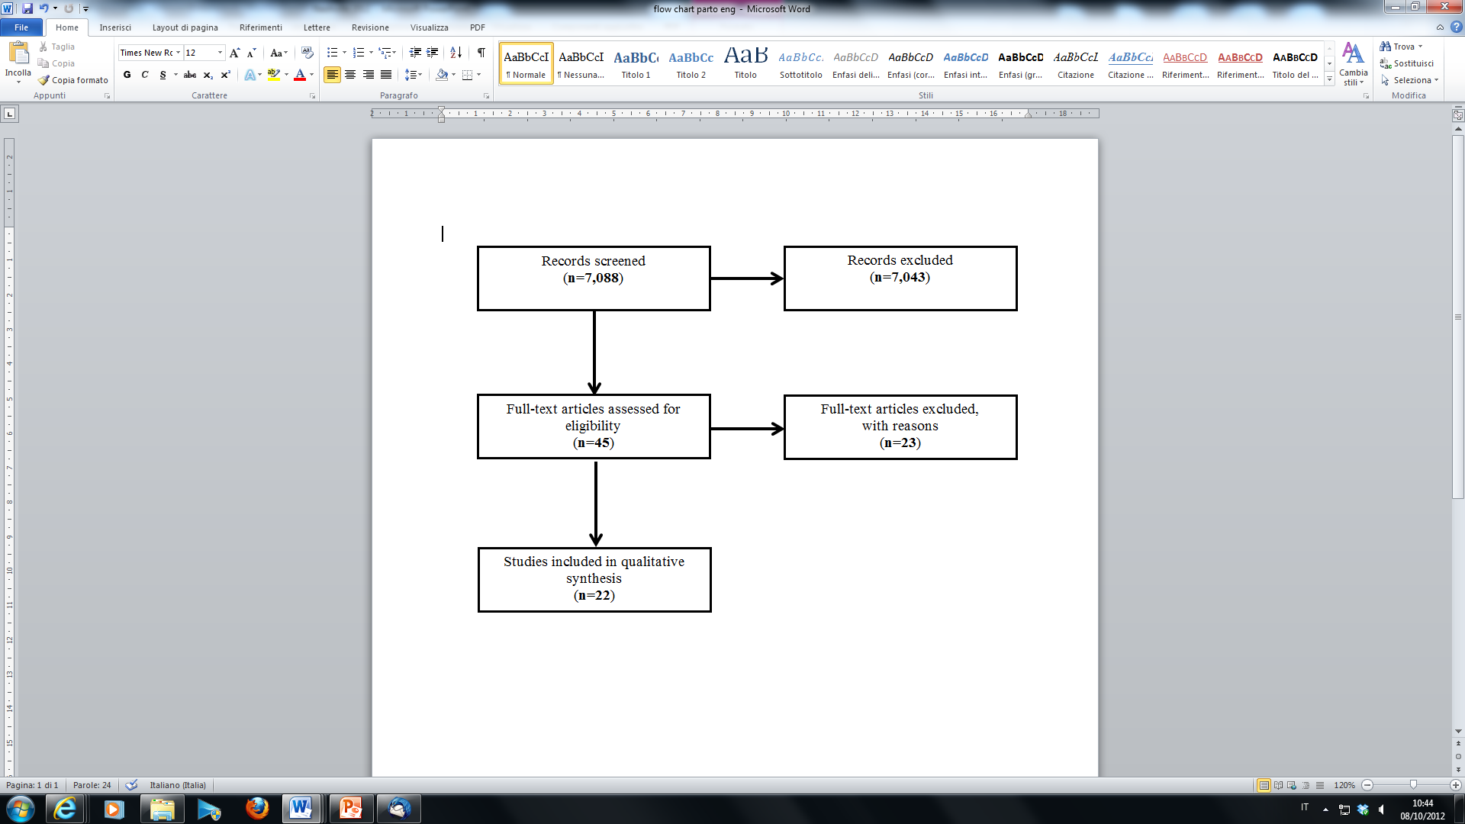
Flow Chart
Notes:
Here is presented the flow chart, in total 22 primary studies have been included in the review, 21 evaluating the association between hospital volume and neonatal (10 studies) /maternal (11 studies) outcomes.
Most of the studies were performed in US.
Now I am going to present you only preliminary results of this systematic review.

Slide 19
Results
Hospital volume – maternal outcomes (10 studies)
3/10 studies considered mothers with specific conditions (ie Diabetes)
Main Outcomes:
  Caesarian delivery rates (n 6)
  Complications (n 6)
Notes:
Eleven studies assessed the association between hospital volume and maternal outcomes, in three of them the study population was represented by mothers with specific conditions like diabetes. Main outcome considered was the rate of caesarian delivery.

Slide 20
Sarria Santamera 2003 | 257,987 deliveries | Hospitals Spain | < 600 Deliveries 601-1000 Deliveries >1000 Deliveries (high volume) | Criteria cut-off NS
Garcia 2001 | 63,143 births | Public Hospitals USA | <1000 deliveries 1001-2000 deliveries 2001-4000 deliveries >4000 deliveries (high volume) | Criteria cut-off NS
Tracy 2006 | 331,147 mothers low risk | Hospitals Australia | <100 deliveries 100–500 deliveries 501–1000 deliveries 1001–2000 deliveries ≥ 2001 deliveries (high volume)
Ba’aqeel 2009 | No population data reported | Hospitals Saudi Arabia | <7.500 deliveries 7.500-15.000 deliveries >15.000 deliveries | Criteria cut-off NS
Grobman 2006 | 175,374 deliveries | Public Hospitals USA | <1198 deliveries 1198-1912 deliveries 1193-2566 deliveries >2566 deliveries (high volume) | Criteria cut-off NS
Linton 2004 | 53,215 births | Military Hospitals USA | <500 deliveries 500– 1,199 deliveries 1,200 –2,000 deliveries > 2,000 deliveries (high volume) | Criteria cut-off NS
Notes:
Six studies reported data on caesarian delivery, cut off values for high volumes differ among studies, almost all the studies did not report the definition of criteria used for cut-off.

Slide 21
Results
Hospital volume- neonatal outcomes (10 studies)
5/10 studies VLBW infants
Main Outcome:
  Intra-hospital/neonatal mortality
Notes:
10 studies evaluated the association between hospital volume and neonatal outcomes, half of them considering as study population very low birth weight infants (weight less than 1,500 grams). Main outcome studied was mortality , intra-hospital and within 28 days from birth).

Slide 22
Chung 2010 | 28,718 VLBW infants | Public hospitals USA | 1-10 deliveries 11-25 deliveries 26-50 deliveries 51-100 deliveries >100 deliveries (high volume) | criteria cut-off NS
Bartels 2006 | 4,379 VLBW infants (24th 30th week) | Public hospitals Germany | ≤1000 deliveries >1000 deliveries (high volume)
Wehby 2012 (HSR) | 4,553 VLBW infants | Public hospitals USA | ≤ 50 VLBW 51-100 VLBW > 100 VLBW (high volume)
Wehby 2012 Med Care | 679 VLBW infants and 1,487 neonates <32 weeks | Public hospitals Argentina, Brazil, Chile | ≤25 VLBW (low volume) 26–48 VLBW 49–92 VLBW 93–96 VLBW 97-120 VLBW 121-144 VLBW 145-192 VLBW >192 VLBW | criteria cut-off NS
Roowsky 2004 | 94,110 VLBW infants | Public hospitals USA | <50 parti VLBW ≥50 parti VLBW (high volume) | criteria cut-off NS
Notes:
In particular, looking at the data coming from the 5 studies on VLBW infants, emerges the variability of cut-off values used for the definition of high volume, in one case low volume was defined. Moreover, in some cases criteria for their definition were not even described ( ie from the study of Bartels where criteria for cut-off came from the quality insurance programme of the Center for Quality Management)

Slide 23
Keypoints
Developing the SR of primary studies, we encountered similar problems of the overview.
Moreover, studies greatly differed for study population:
  mothers with gestational diabetes
  premature or Very Low Birth Weight (VLBW) infants
  Twin deliveries
  Vaginal birth after caesarean (VBAC)
Finally, the association between hospital volume and outcomes might have been influenced by the presence of Neonatal Intensive Care Units (in particular for VLBW infants) which are known to be strongly correlated to the outcome.
Notes:
This systematic review showed some methodological issues similar to those described before for the overview, reflecting the heterogeneity of studies included. Moreover, here studies greatly differed for study population, many assessing outcomes in high risk groups as premature or Very Low Birth Weight (VLBW) infants, twin deliveries, Vaginal birth after delivery, mothers with gestational diabetes.
In this particular case, furthermore, the association between hospital volume and outcomes might have been influenced by the presence of Neonatal Intensive Care Units which are known to be strongly correlated to the outcome.

Slide 24
Conclusion
Overview of reviews
Positive association for some interventions
No association only for 2 intervention
No available evidence for other procedures
No high volume threshold identified
Notes:
The overview of reviews permitted to identify health conditions for which there is an association between volume of care and outcomes.
For very few interventions (hip arthroplasty and surgery of rectal cancer) there was no evidence of association but maybe “mortality” does not represent the right outcome for such interventions.
For some other procedures we did not find enough evidence (only very old reviews)
No threshold for high volume has been identified.

Slide 25
Conclusion
SR of primary studies -Delivery
Meta-analysis possible/meaningful?
Publication bias
Outcome reporting bias
No high volume threshold identified
Notes:
With regard on the systematic review of primary studies on delivery, the following issues could be discussed:
- Is it possible to pool data coming from these studies?
Publication bias
Outcome publication bias (when the outcome showed is present only in the subgroup)
Reporting bias

Slide 26

Thanks for your attention
Notes:
Thank you very much for your attention

